Slide 1
Applications of text mining and NLP
Anastasia Giachanou

Slide 2
Summary
Text -> Numeric
TF; TF-IDF; Word embeddings
Similarity (often cosine similarity)
Clustering
LDA
Classification
TF-IDF (+ Dimensionality reduction) + Classifier (e.g. LogisticRegression)
Word embeddings + Classifier (e.g. LogisticRegression)
Neural Networks (Feed-forward, RNN, LSTM, CNN, Transformers)
Notes:
where news broadly includes articles, claims, statements, speeches, posts, among other types of information related to public figures and organizations. The broad definition aims to impose minimum constraints in accord with the current resources: it emphasizes information authenticity, purposefully adopts a broad definition for the term news [Vosoughi et al. 2018], and weakens the requirement for information intention due to the difficulty in obtaining the ground truth (true intention). This definition supports most existing fake-news-related studies and datasets, as provided by the existing fact-checking websites
This narrow definition addresses the public’s perception of fake news, especially following the 2016 U.S. presidential election. Note that deceptive news is more harmful and less distinguishable than incautiously false news, as the former pretends to be truth to mislead the public better. The narrow definition emphasizes both news authenticity and intentions; it also ensures the posted information is news by investigating if its publisher is a news outlet (e.g., CNN and New York Times). Often news outlets publish news in the form of articles with fixed components: a title, author(s), a body text, image(s) and/or video(s) that include the claims made by, or about, public figures and organizations.

Slide 3
A collection of text mining applications
Can you think of some text mining applications?
Notes:
where news broadly includes articles, claims, statements, speeches, posts, among other types of information related to public figures and organizations. The broad definition aims to impose minimum constraints in accord with the current resources: it emphasizes information authenticity, purposefully adopts a broad definition for the term news [Vosoughi et al. 2018], and weakens the requirement for information intention due to the difficulty in obtaining the ground truth (true intention). This definition supports most existing fake-news-related studies and datasets, as provided by the existing fact-checking websites
This narrow definition addresses the public’s perception of fake news, especially following the 2016 U.S. presidential election. Note that deceptive news is more harmful and less distinguishable than incautiously false news, as the former pretends to be truth to mislead the public better. The narrow definition emphasizes both news authenticity and intentions; it also ensures the posted information is news by investigating if its publisher is a news outlet (e.g., CNN and New York Times). Often news outlets publish news in the form of articles with fixed components: a title, author(s), a body text, image(s) and/or video(s) that include the claims made by, or about, public figures and organizations.

Slide 4
A collection of text mining applications
Similarity
Find authors of an anonymous book
Find duplicates and link records
Find relevant documents given a user query
Clustering
Targeted advertisement or learning
Recommendation systems (e.g. similar books)
Clustering stories (clustering fiction works, people’s diagnoses, misinformation)
Track evolution of topics in discourse
Classification/Regression
Hate speech classification (similar: spam, fake news)
Sentiment and emotion analysis
Predict student performance
Probability of re-hospitalization
Classifying reports (e.g. hospital discharges, urgent issues)
Predict stock market returns

Slide 5
Today
Applications of text mining
Fake news detection
Hate speech detection
Text clustering in media
Healthcare applications
Interpretability
*50% of the presentation is based on a lecture given by Javier Garcia-Bernardo

Slide 6
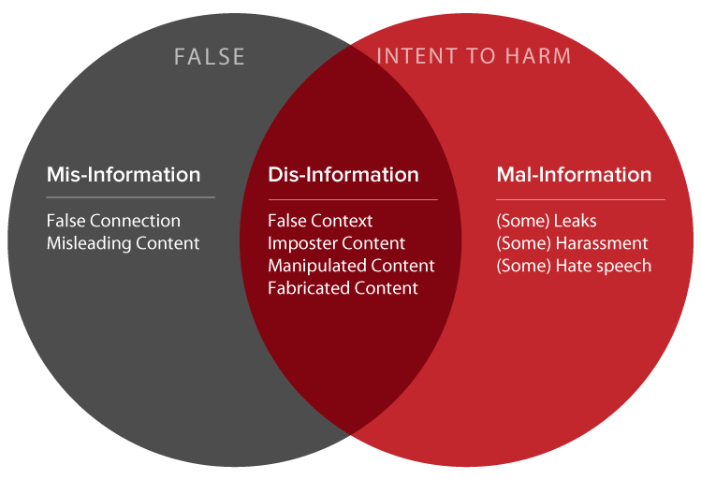
Information disorder online
What about machine generated text?
Council of Europe. https://www.coe.int/en/web/freedom-expression/information-disorder

Slide 7

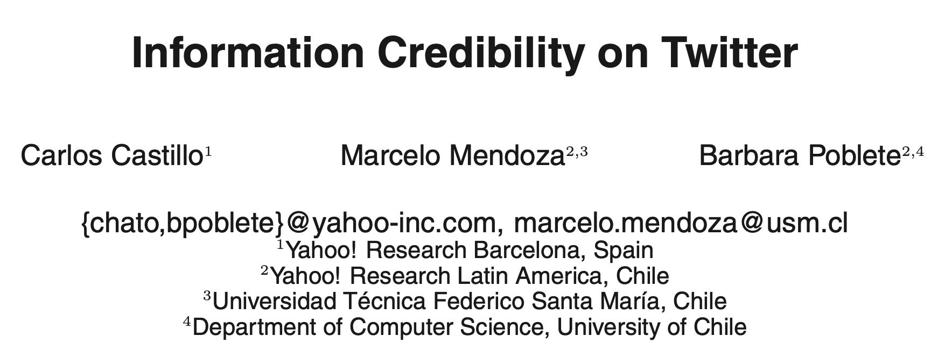
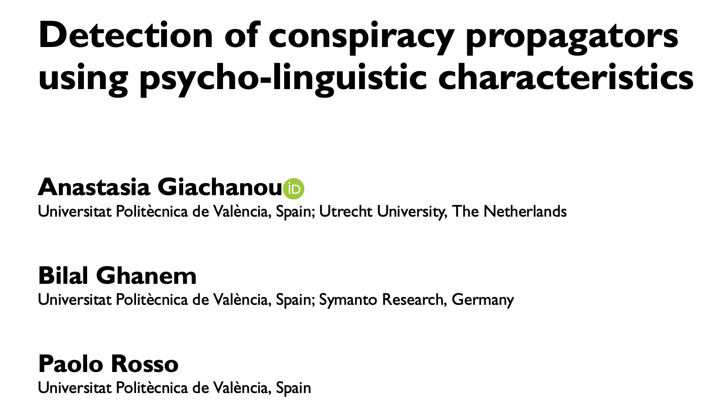
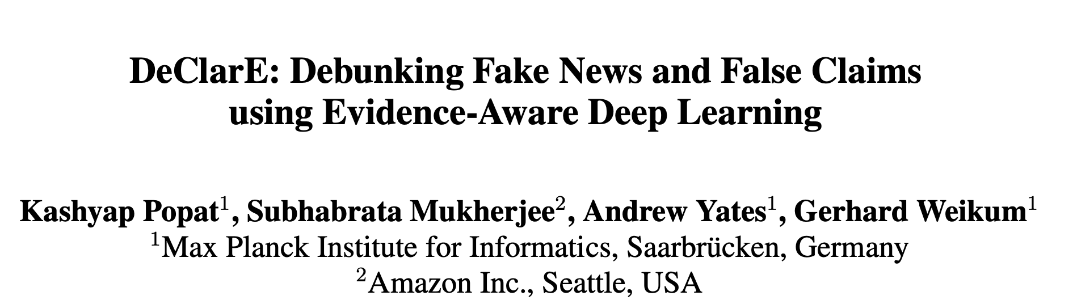
Fake news detection

Slide 8
Definition of fake news
A news article that is intentionally and verifiably false
where news broadly includes articles, claims, statements, speeches, posts, among other types of information related to public figures and organizations
Fake news is intentionally false news published by a news outlet
emphasizes both news authenticity and intentions; it also ensures the posted information is news by investigating if its publisher is a news outlet
K. Shu, A. Sliva, S. Wang, J. Tang, and H. Liu. (2017). Fake news detection on social media: A data mining perspective. ACM SIGKDD Explorations Newsletter 19, 1 (2017), 22–36
Notes:
where news broadly includes articles, claims, statements, speeches, posts, among other types of information related to public figures and organizations. The broad definition aims to impose minimum constraints in accord with the current resources: it emphasizes information authenticity, purposefully adopts a broad definition for the term news [Vosoughi et al. 2018], and weakens the requirement for information intention due to the difficulty in obtaining the ground truth (true intention). This definition supports most existing fake-news-related studies and datasets, as provided by the existing fact-checking websites
This narrow definition addresses the public’s perception of fake news, especially following the 2016 U.S. presidential election. Note that deceptive news is more harmful and less distinguishable than incautiously false news, as the former pretends to be truth to mislead the public better. The narrow definition emphasizes both news authenticity and intentions; it also ensures the posted information is news by investigating if its publisher is a news outlet (e.g., CNN and New York Times). Often news outlets publish news in the form of articles with fixed components: a title, author(s), a body text, image(s) and/or video(s) that include the claims made by, or about, public figures and organizations.

Slide 9
Difficult to be detected by humans
Human ability to detect deception is only slightly better than chance: accuracy rates are in the 55%-58% range
Individuals trust fake news after repeated exposures (validity effect) or if it confirms their preexisting beliefs (confirmation bias) or if it pleases them (desirability bias)
Peer pressure “controls” our perception and behavior (e.g., bandwagon effect)
Notes:
Studies in social psychology and communications have demonstrated that human ability to detect deception is only slightly better than chance: typical accuracy rates are in the 55%-58% range, with a mean accuracy of 54% over 1,000 participants in over 100 experiments [Rubin 2010]. The situation is more critical for fake news than other types of information.
For news, where one expects authenticity and objectivity, it is relatively easier to gain public trust. In addition, individuals tend to trust fake news after repeated exposures (validity effect [Boehm 1994]), or if it confirms their preexisting beliefs (confirmation bias [Nickerson 1998]) or attitudes (selective exposure [Freedman and Sears 1965; Metzger et al. 2015]), or if it pleases them (desirability bias [Fisher 1993]).
Peer pressure can also at times “control” our perception and behavior (e.g., bandwagon effect [Leibenstein 1950]).

Slide 10
Travel fast and more
Research has shown that compared to the truth, fake news on Twitter is typically retweeted by many more users and spreads far more rapidly, especially for political news
During the 2016 U.S. presidential election campaign, the top twenty frequently-discussed fake election stories generated 8,711,000 shares, reactions, and comments on Facebook, ironically, more than the 7,367,000 for the top twenty most-discussed election stories
S. Vosoughi, D. Roy, and S. Aral. (2018). The spread of true and false news online. Science 359, 6380, 1146–1151.
C. Silverman. (2016). This analysis shows how viral fake election news stories outperformed real news on Facebook. BuzzFeed News 16

Slide 11
The role of content
Fake news potentially differ from the truth in terms of:
writing style and quality (by Undeutsch hypothesis)
quantity such as word counts (by information manipulation theory)
sentiments expressed (by four-factor theory)
U. Undeutsch. 1967. Beurteilung der glaubhaftigkeit von aussagen. Handbuch der psychologie 11, 26–181
S. A McCornack, K. Morrison, J. E. Paik, A. M Wisner, and X. Zhu. 2014. Information manipulation theory 2: A propositional theory of deceptive discourse production. Journal of Language and Social Psychology 33, 4 (2014), 348–377
M. Zuckerman, B. M DePaulo, and R. Rosenthal. 1981. Verbal and Nonverbal Communication of Deception1. In Advances in experimental social psychology. Vol. 14. Elsevier, 1–59

Slide 12
Information credibility on Twitter
Assessing the credibility of a given set of tweets
Data collection: collected all the tweets matching queries during a 2-days window; 2,500 topics; Amazon Mechanical Turk
Features:
Message-based: tweet length, existence of special chars, sentiment, etc.
User-based: registration age, number of followers, followees, etc.
Topic-based: the fraction of tweets with URL, fraction of positive, etc.
Propagation-based: depth of a re-tweet, number of initial tweets of a topic
Decision Tree classifier
C. Castillo, M. Mendoza, and B. Poblete. (2011). Information credibility on Twitter. In Proceedings of the 20th international conference on World wide web, pp. 675-684

Slide 13
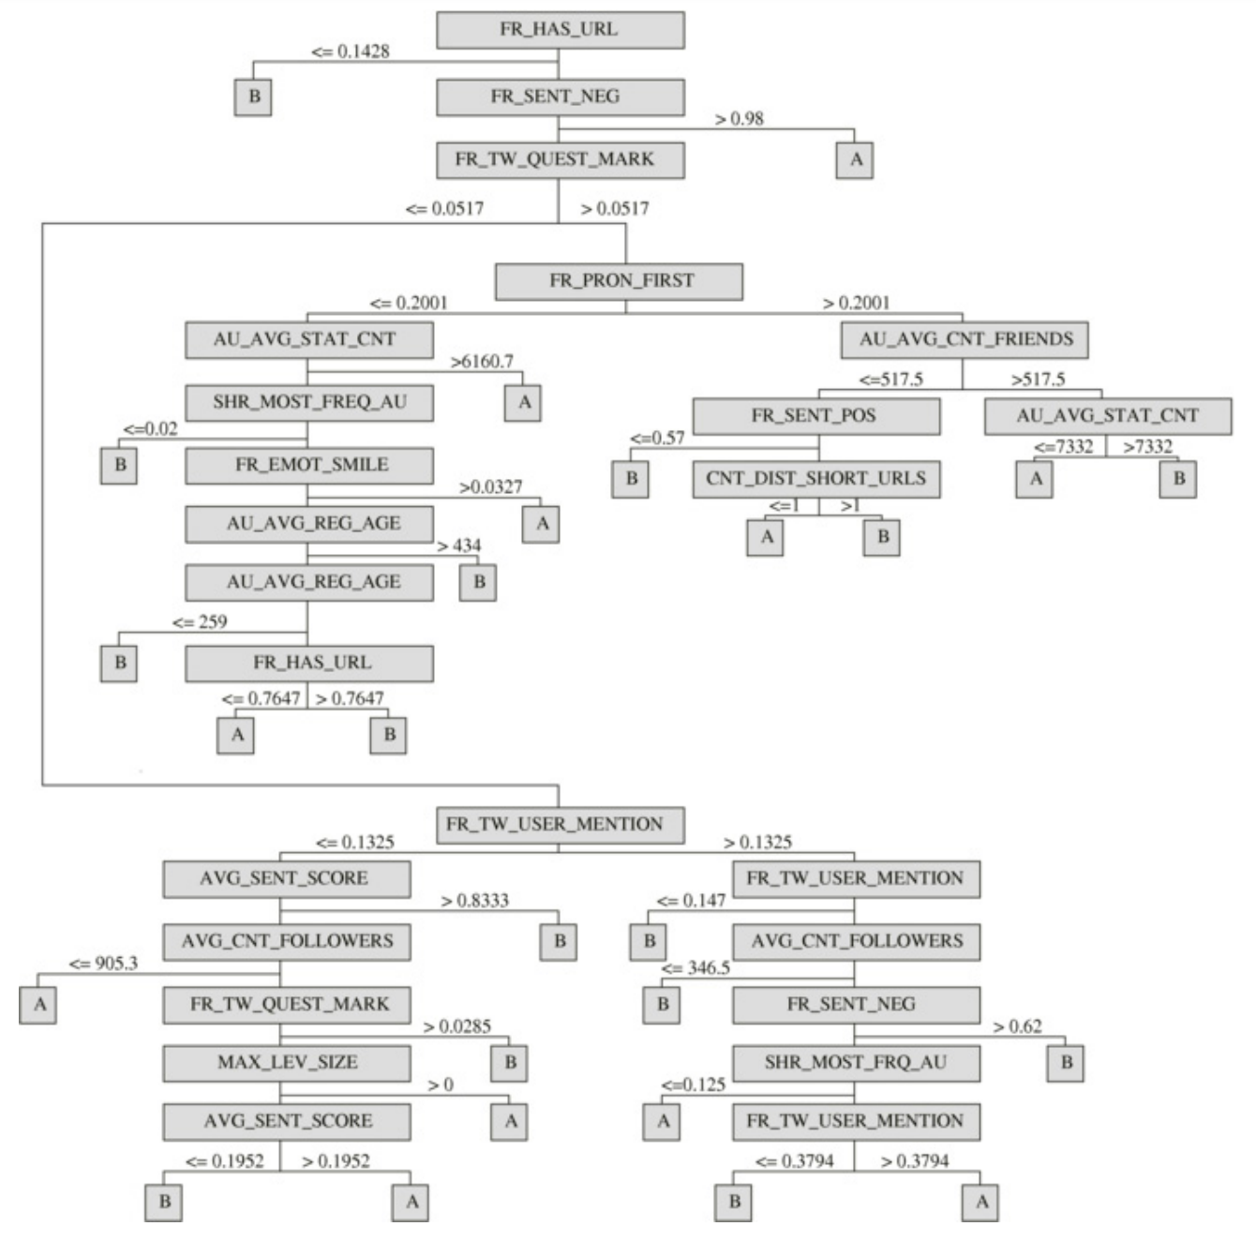
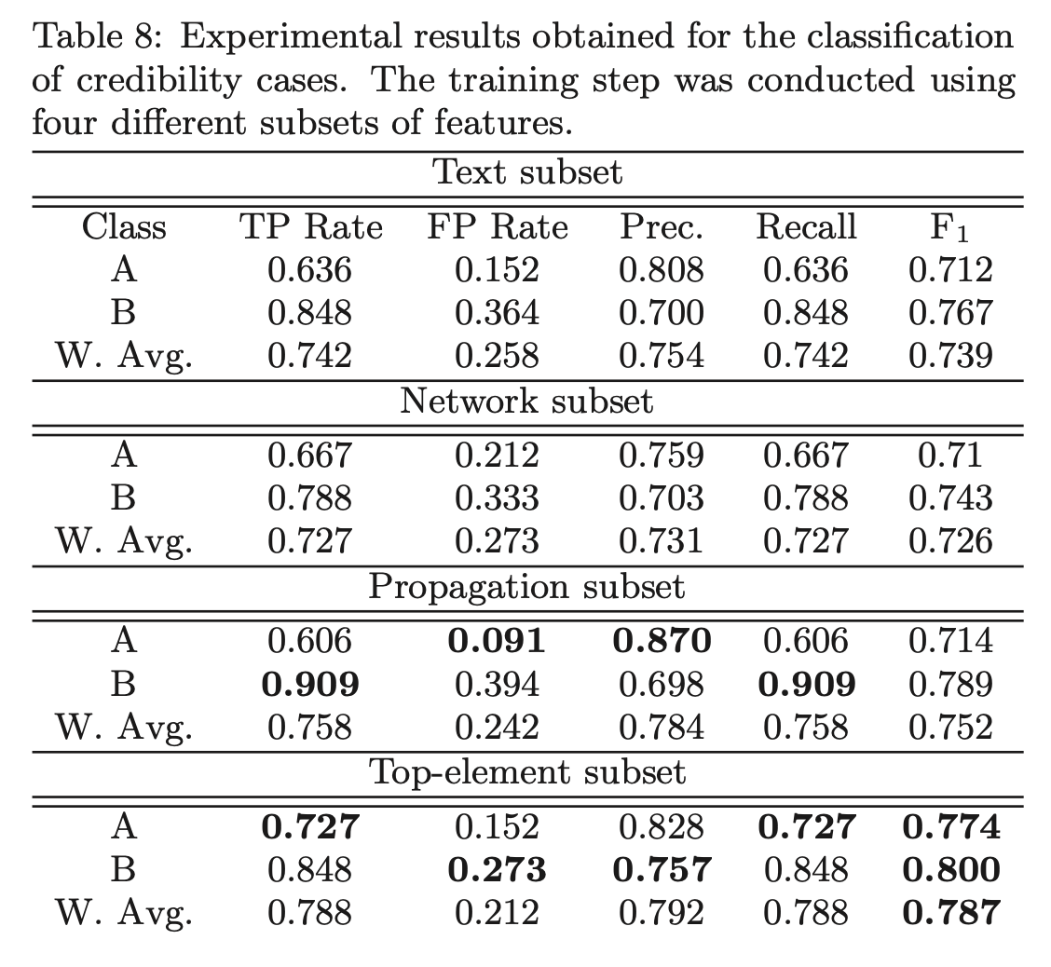
C. Castillo, M. Mendoza, and B. Poblete. (2011). Information credibility on Twitter. In Proceedings of the 20th international conference on World wide web, pp. 675-684

Slide 14
Fake news early detection: A theory-driven model
Features:
Lexicon-level (e.g., BoW)
Syntax-level (e.g., POS)
Semantic-level (e.g., General Clickbait Patterns, Readability, Sensationalism, News-worthiness)
Discourse-level (Rhetorical Relationships)
Several supervised classifiers with five-fold cross-validation
SVM, Random Forest, and XGBoost perform best
PolitiFact and BuzzFeed
X. Zhou, A. Jain, V. V. Phoha, and R. Zafarani. (2019). Fake News Early Detection: A Theory-driven Model. arXiv preprint arXiv:1904.11679
Notes:
a rhetorical relation is a pragmatic function that one utterance (or larger stretch of text) fulfils with respect to another.
rhetorical relations express what a sentence does, i.e. what it effects in communication. However, RR do so by expressing what a sentence does to another sentence.

Slide 15
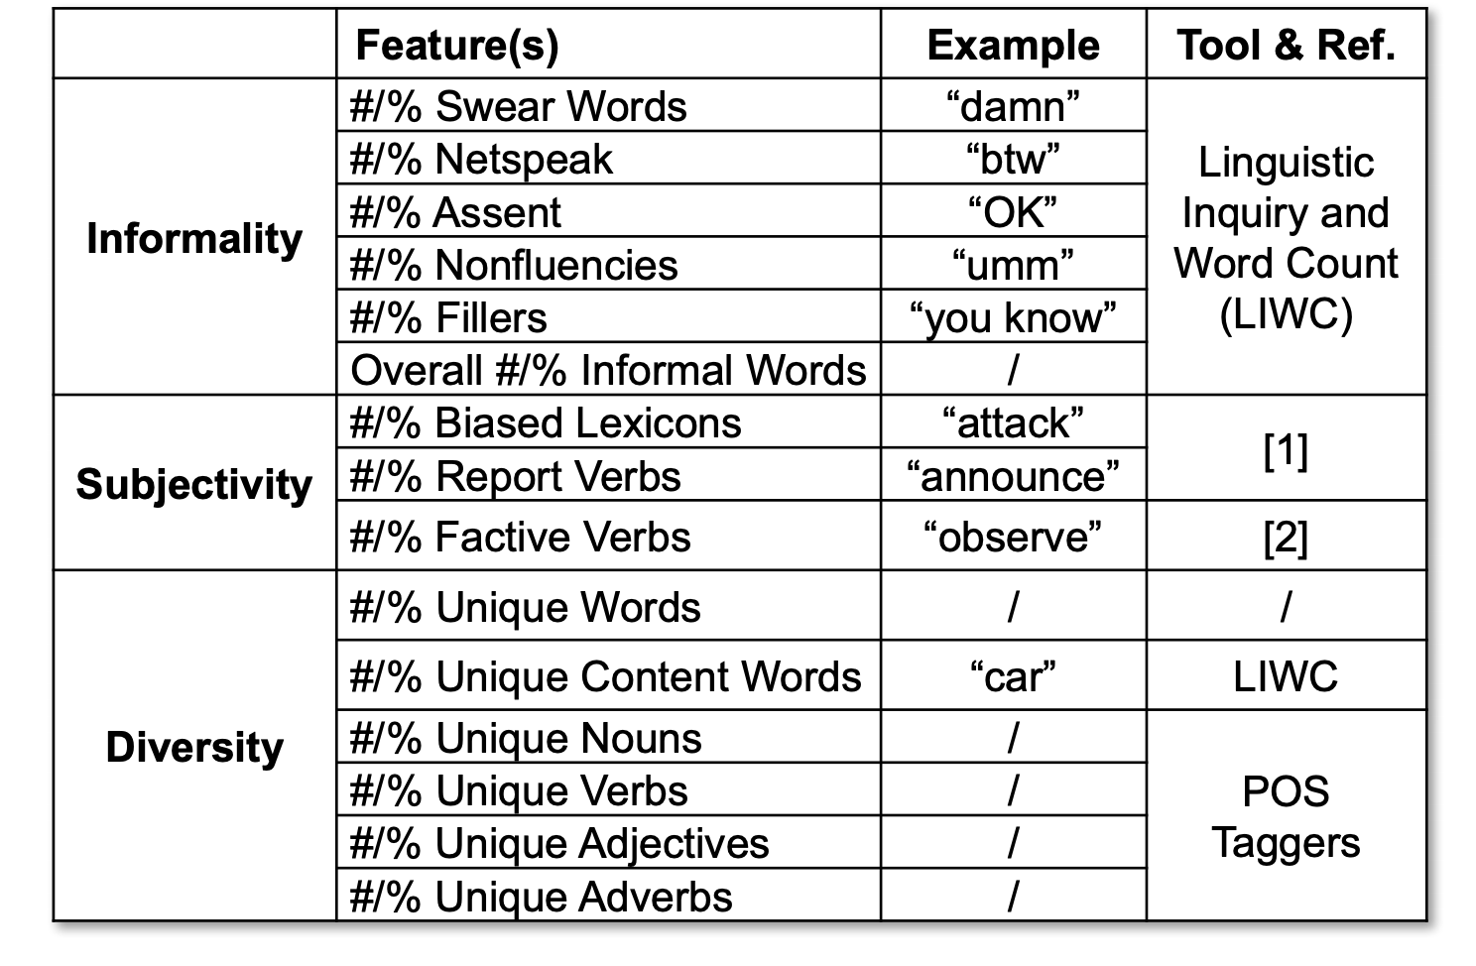
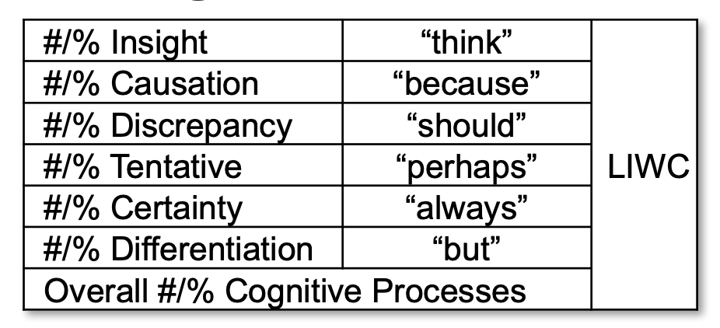
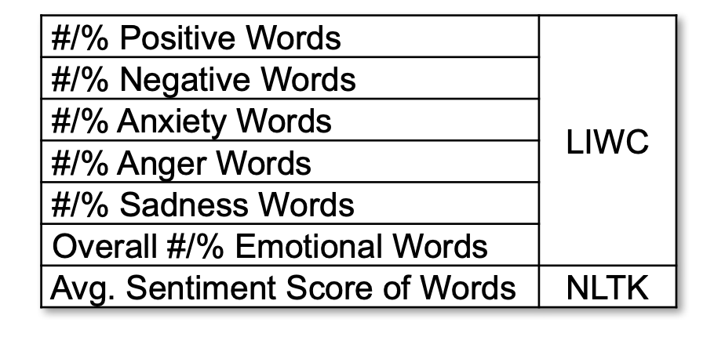
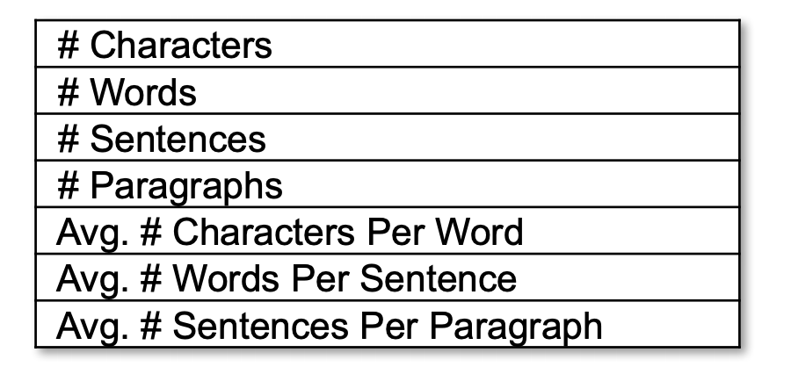
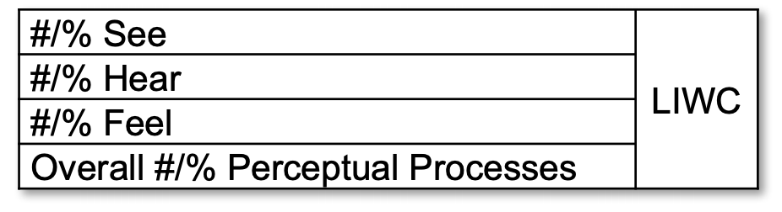
Content Quality
Cognitive Process
Sentiment
Quantity
Perceptual Process
X. Zhou, A. Jain, V. V. Phoha, and R. Zafarani. (2019). Fake News Early Detection: A Theory-driven Model. arXiv preprint arXiv:1904.11679

Slide 16
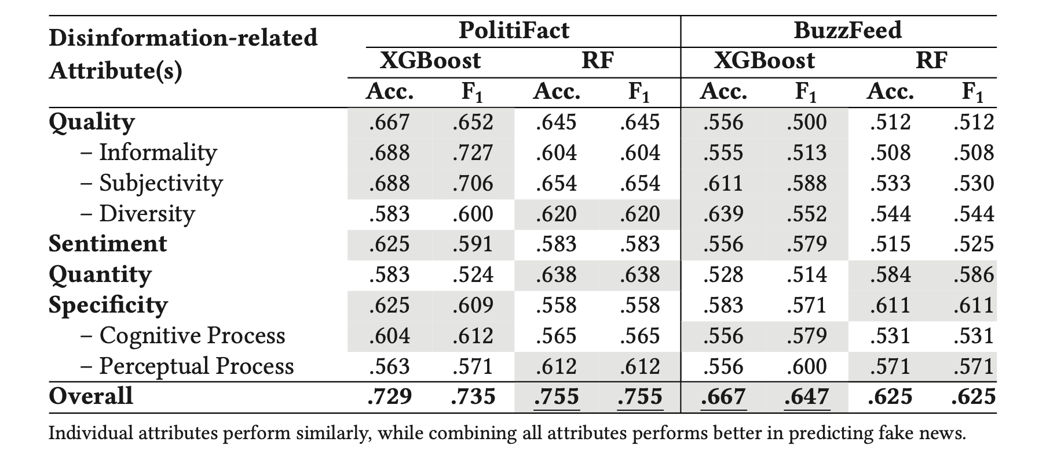
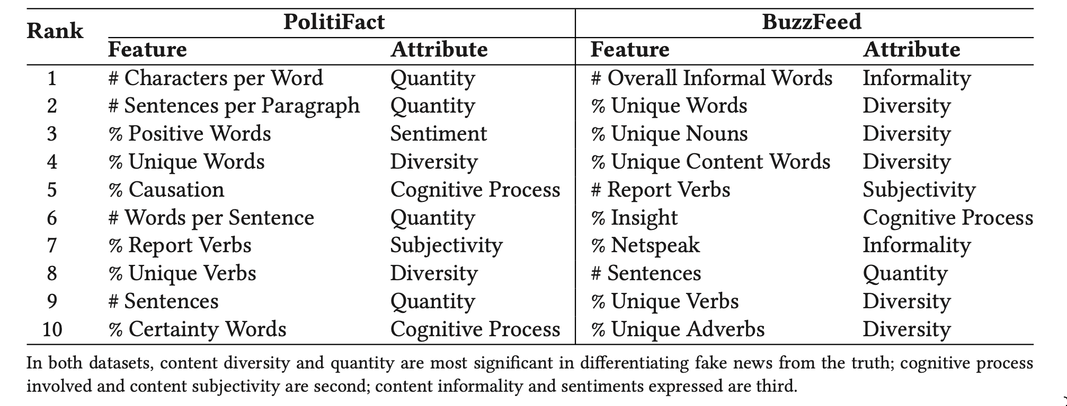
X. Zhou, A. Jain, V. V. Phoha, and R. Zafarani. (2019). Fake News Early Detection: A Theory-driven Model. arXiv preprint arXiv:1904.11679

Slide 17
Declare: Debunking fake news and false claims using evidence-aware deep learning
Credibility of arbitrary claims made in natural language text
Data collection:
Snopes: 4341 claims;PolitiFact: 3568 claims; NewsTrust: 5344 claims; RumorEval-2017: 272 claims
Each claim as a query to BING search engine and retrieve the top 30 search results with their respective web sources
K. Popat, S. Mukherjee, A. Yates, and G. Weikum. (2018). DeClarE: Debunking Fake News and False Claims using Evidence-Aware Deep Learning. In Proceedings of the 2018 Conference on Empirical Methods in Natural Language Processing, pp. 22-32

Slide 18
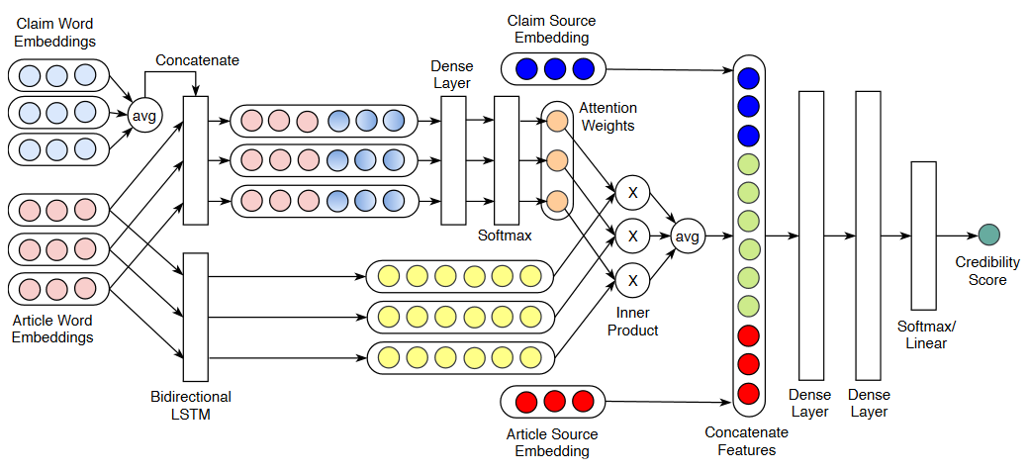
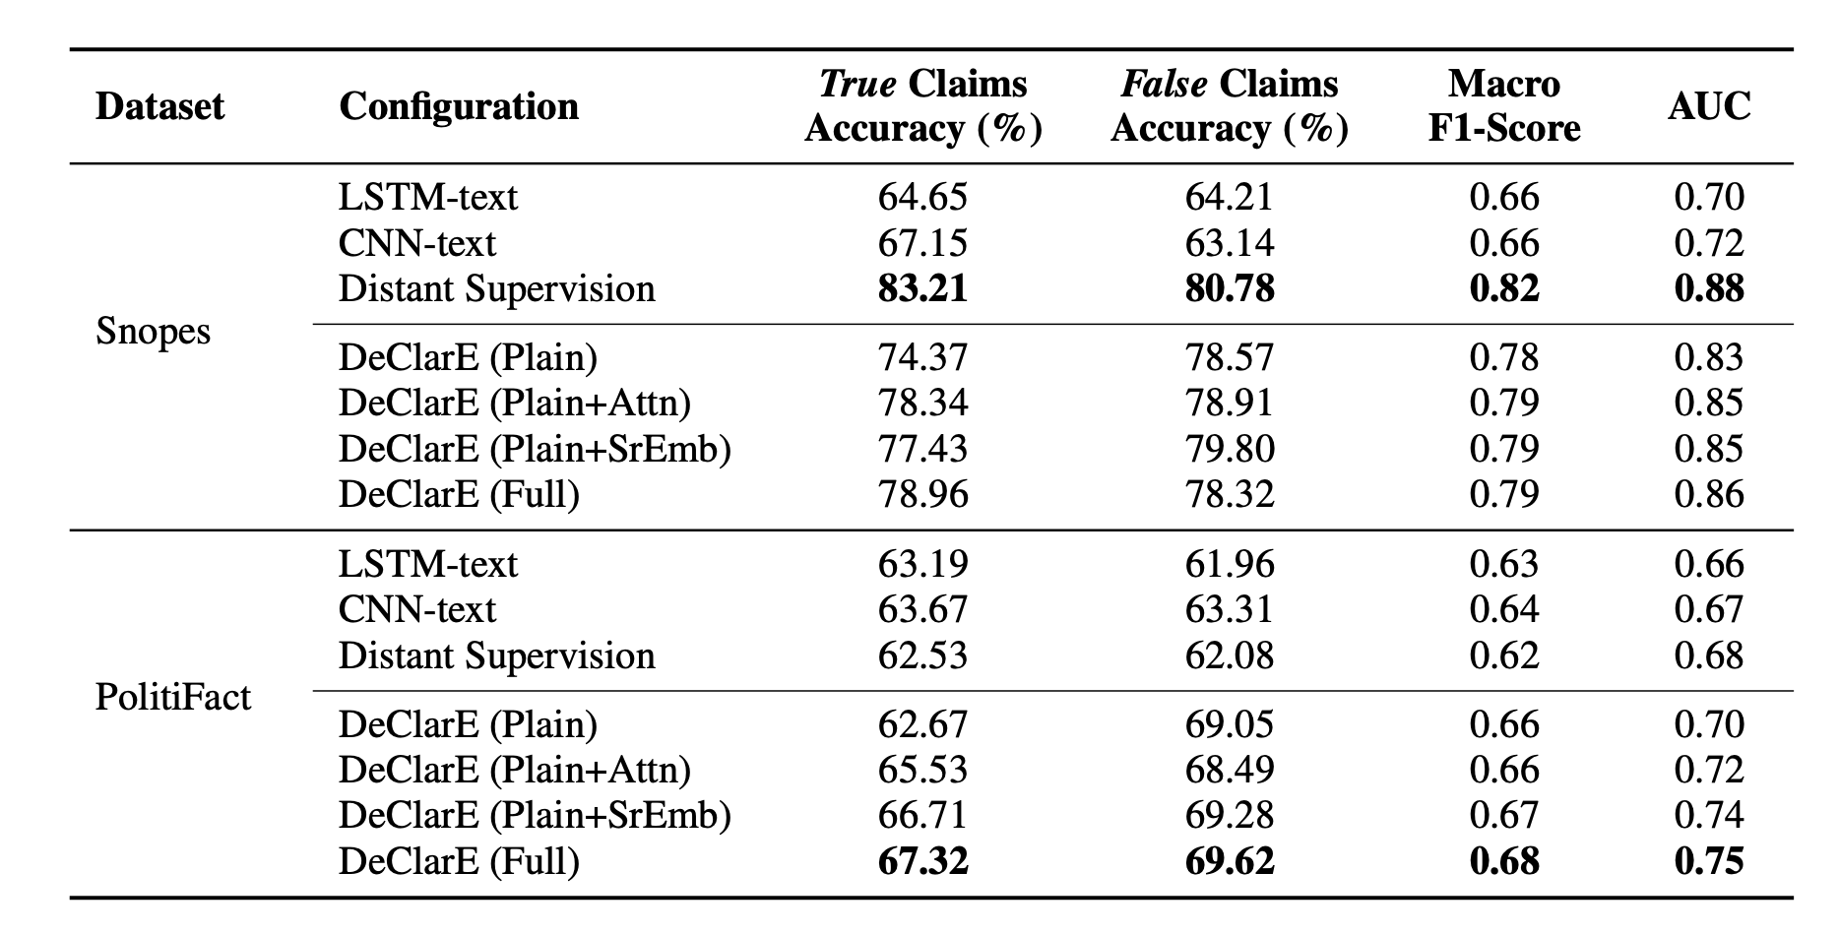
K. Popat, S. Mukherjee, A. Yates, and G. Weikum. (2018). DeClarE: Debunking Fake News and False Claims using Evidence-Aware Deep Learning. In Proceedings of the 2018 Conference on Empirical Methods in Natural Language Processing, pp. 22-32

Slide 19
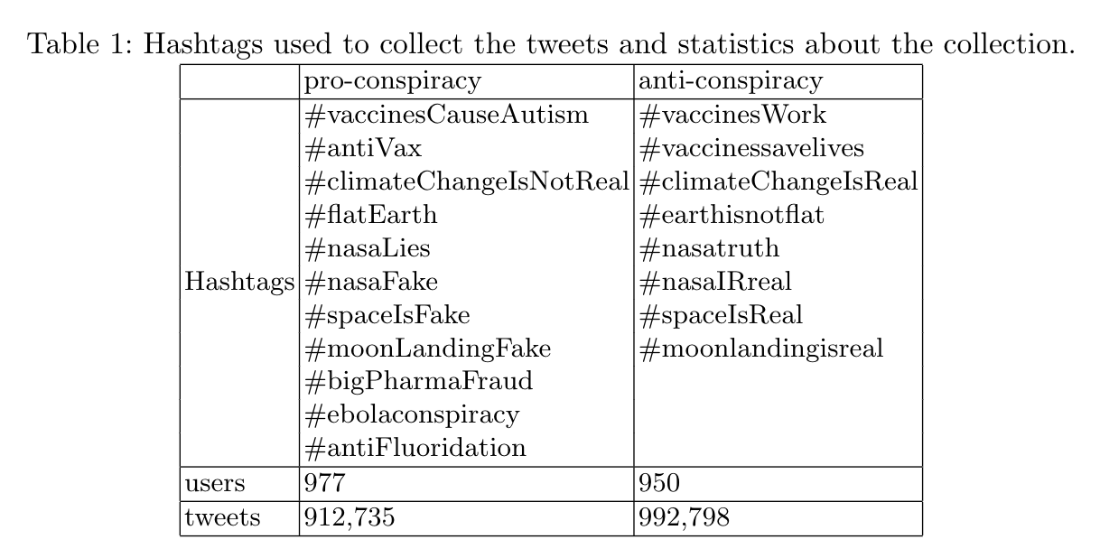
Read this before they delete it: A psycho-linguistic analysis of conspiracy theorists
Opponents have:
old and verified accounts
a larger number of statuses
higher usage of work, leisure, money, home, and death, causation (because, effect, hence)
Supporters have:
less followers, less statuses, favorites and friends
concern more about religion
use more swear words
Giachanou, A, Ghanem, B. , Rosso, P. "Detection of conspiracy propagators using psycho-linguistic characteristics." Journal of Information Science 49.1 (2023): 3-17.

Slide 20
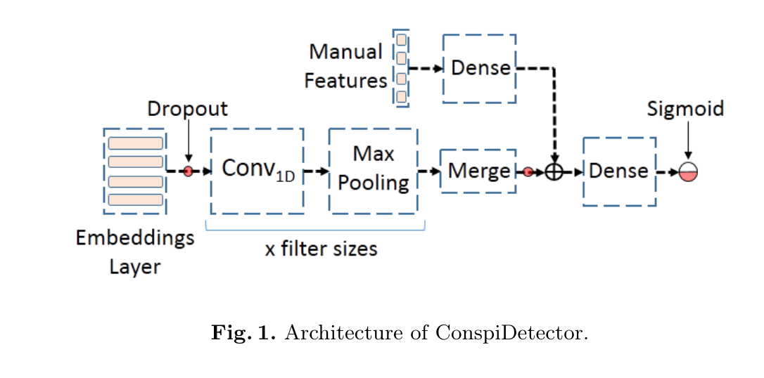
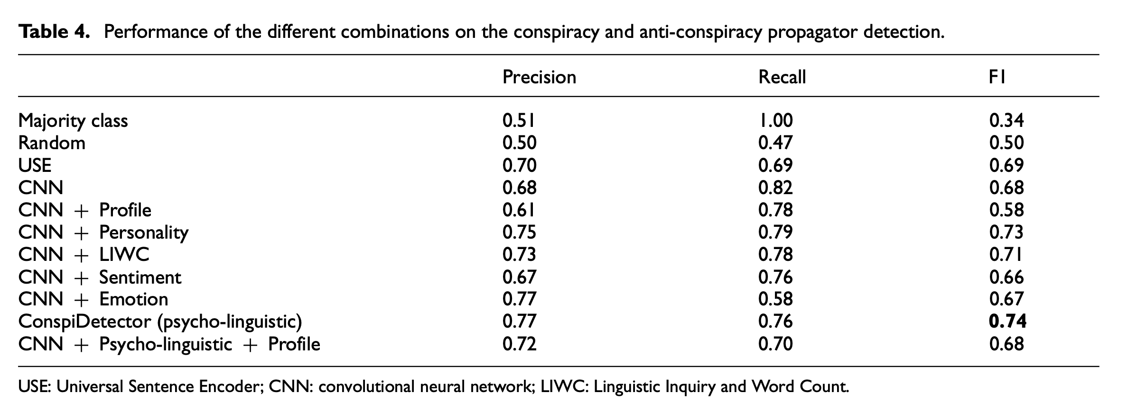
Read this before they delete it: A psycho-linguistic analysis of conspiracy theorists
Giachanou, A, Ghanem, B. , Rosso, P. "Detection of conspiracy propagators using psycho-linguistic characteristics." Journal of Information Science 49.1 (2023): 3-17.

Slide 21
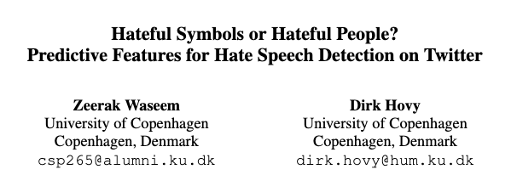
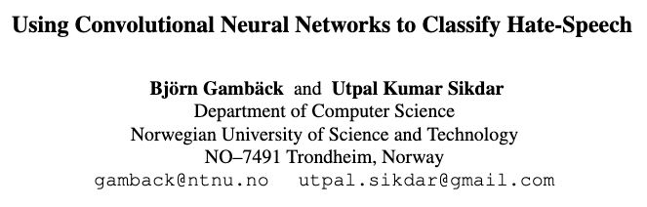
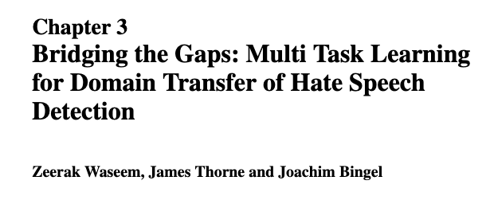
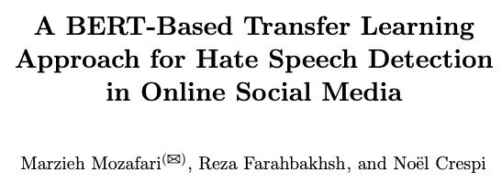
Hate Speech in Twitter
Notes:
2016
2016
2017
2019

Slide 22
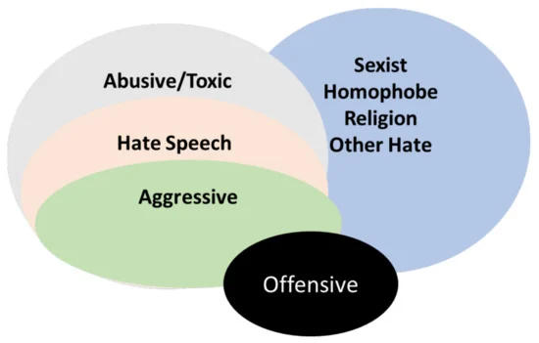
Hate Speech
Social media enable the propagation of hate speech
Hate speech detection is crucial to reducing crime and protecting people’s beliefs
On July 13, D66 leader Sigrid Kaag announced her decision not to continue in politics via Twitter. She mentions "hate, intimidation and threats" in the statement and the effect on her family is the reason to stop.
https://nos.nl/nieuwsuur/artikel/2482833-toelichting-twitter-reacties-op-vertrek-sigrid-kaag
Notes:
When would you remove ”not” as a stop word?
We provide a data set of 16k tweets annotated for hate speech. We also inves- tigate which of the features we use provide the best identification performance. We analyze the features that improve detection of hate speech in our corpus, and find that despite presumed differ- ences in the geographic and word-length distribu- tion, they have little to no positive effect on per- formance, and rarely improve over character-level features. The exception to this rule is gender.
manually annotated our data set
We find that the most influential features for the logistic regression (see Table 5) largely correspond with the most frequent terms in Table 2. We see, for instance different n-gram lengths of the word “Islam” and “sexist”.
Intuitively, it makes sense that not only will the most frequent terms be indicative, but also that character n-grams would outperform word n- grams, due to character n-gram matrices being far less sparse than the word n-gram matrices.

Slide 23
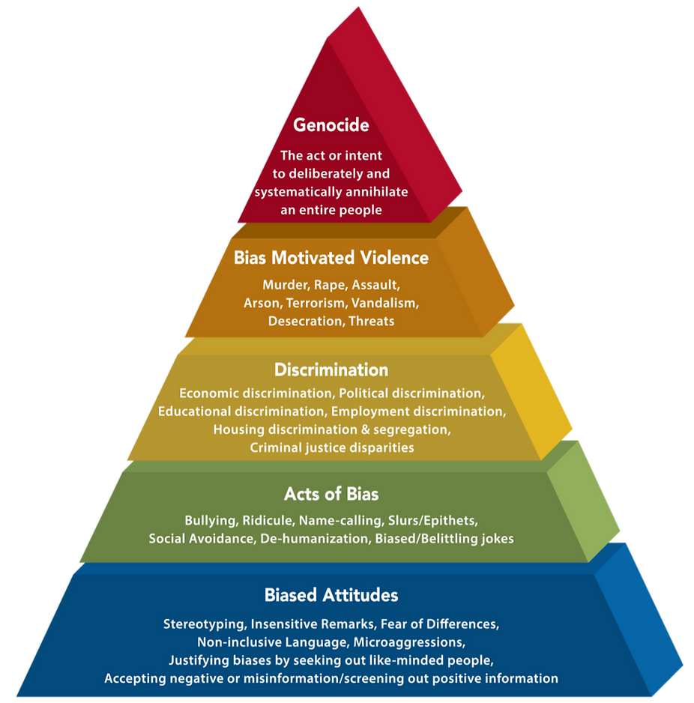
Hate Speech Pyramid
The 2019 UN Strategy and Plan of Action on Hate Speech
‘Attacks or uses pejorative or discriminatory language with reference to a person or a group on the basis of who they are, in other words, based on their religion, ethnicity, nationality, race, colour, descent, gender, or other identity factor’.
Genocidal acts cannot occur without being upheld by the lower stages that act as a base for mass atrocities.
Notes:
Biased Attitudes, form the bedrock that enables escalation of hate and discrimination
Progression towards Acts of Bias, including dehumanisation and slurs, to Discrimination, Violence and, eventually, Genocide

Slide 24
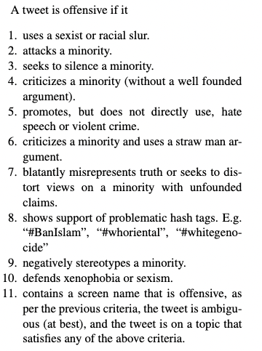
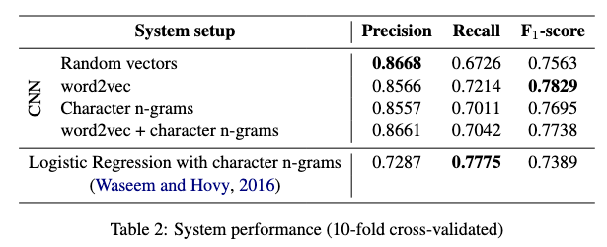
Hateful Symbols
Data: Annotation of 16k tweets based on Gender studies and Critical Race Theory (CRT)
Method: TD-IDF using character {uni, bi, tri}-grams.
Why did they use characters instead of words?
Preprocessing: Removing stop words (except “not”), usernames and punctuation
Classifier: Logistic Regression
Results:
Z. Waseem and D. Hovy. 2016. Hateful Symbols or Hateful People? Predictive Features for Hate Speech Detection on Twitter. In Proceedings of the NAACL Student Research Workshop, pages 88–93,. ACL.
Notes:
When would you remove ”not” as a stop word?
We provide a data set of 16k tweets annotated for hate speech. We also inves- tigate which of the features we use provide the best identification performance. We analyze the features that improve detection of hate speech in our corpus, and find that despite presumed differ- ences in the geographic and word-length distribu- tion, they have little to no positive effect on per- formance, and rarely improve over character-level features. The exception to this rule is gender.
manually annotated our data set
We find that the most influential features for the logistic regression (see Table 5) largely correspond with the most frequent terms in Table 2. We see, for instance different n-gram lengths of the word “Islam” and “sexist”.
Intuitively, it makes sense that not only will the most frequent terms be indicative, but also that character n-grams would outperform word n- grams, due to character n-gram matrices being far less sparse than the word n-gram matrices.

Slide 25
Using CNN for Hate Sppech
Data: Waseem&Hovy (2016)
Method: CNN using word embeddings and character n-grams
Word embeddings: word2vec and random vectors
Preprocessing: None
Classifier: Softmax
Results:
B. Gambäck and U. Kumar Sikdar. 2017. Using Convolutional Neural Networks to Classify Hate-Speech. In Proceedings of the First Workshop on Abusive Language Online, pages 85–90, ACL.
Notes:
The classifier assigns each tweet to one of four predefined categories: racism, sexism, both (racism and sex- ism) and non-hate-speech

Slide 26
Multi Task Learning for Hate Speech
Aim: Train a model that is robust across data originating from different distributions and labeled under differing annotation guidelines
Data:
-Waseem & Hovy (2016), 25k annotated tweets, 11-point test based on work in the fields of Gender Studies and CRT, no geographical restriction, (racism, sexism, neither, and both)
-Davidson et al, 2017; Target groups; Twitter guidelines; US data;(hate speech, offensive, and neither)
Best method: Multi-task training. BoW words (5000), bigrams (5000) and character bi/tri-gram (5000)
Feed-forward neural network with 2 hidden layers
Preprocessing: Removing usernames, links and punctuation
Classifier: Softmax
Results:
Waseem, Z., Thorne, J., & Bingel, J. (2018). Bridging the gaps: Multi task learning for domain transfer of hate speech detection. Online harassment, 29-55.
Notes:
Performance depends on data that is annotated by humans. high agreement is difficult due to the subjective nature of the task, and different cultural, geographic and social backgrounds of the annotators.
Furthermore, existing datasets capture only single types of hate speech such as sexism or racism; or single demographics such as people living in the United States, which negatively affects the recall when classifying data that are not captured in the training examples.
To tackle these problems, we make use of multi-task learning (MTL), a machine learning framework that seeks to utilize the similarities and subtle differences in annotations and datasets to improve performance on and regularize against another.
The rationale behind this idea is that certain information, which is encoded in the training data of some task, may help the model generalize better when learning how to make predictions for another related task
25k annotated tweets (92% agreement)
Method: word n-grams (1,2,3 characters) → Less psarse
TF-IDF: Yes
Other features
Classifier: (many) but L2 Logistic Regression best
0.91, 0.9, 0.9
We map the “Neither” class from Talat (2016),Talat and Hovy (2016) to the “Not Offensive” class in Davidson et al. (2017).
We also observe that in Davidson et al. (2017), a large majority of the tweets annotated as offensive language are sexist so we map the “Offensive” class to “Sexist”.
A large majority of the tweets labeled as hate-speech contain racist slurs and remarks, so we map the “Hate Speech” in Davidson et al. (2017) class to the “Racism” class in Talat (2016); Talat and Hovy (2016).

Slide 27
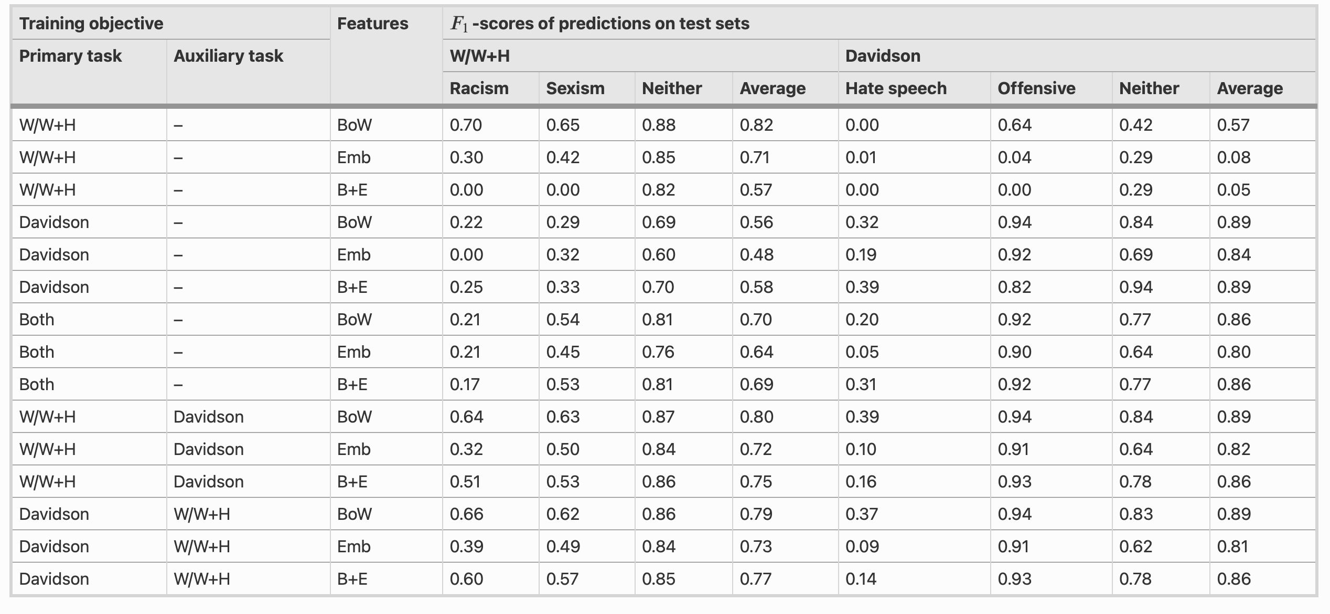
Waseem, Z., Thorne, J., & Bingel, J. (2018). Bridging the gaps: Multi task learning for domain transfer of hate speech detection. Online harassment, 29-55.

Slide 28
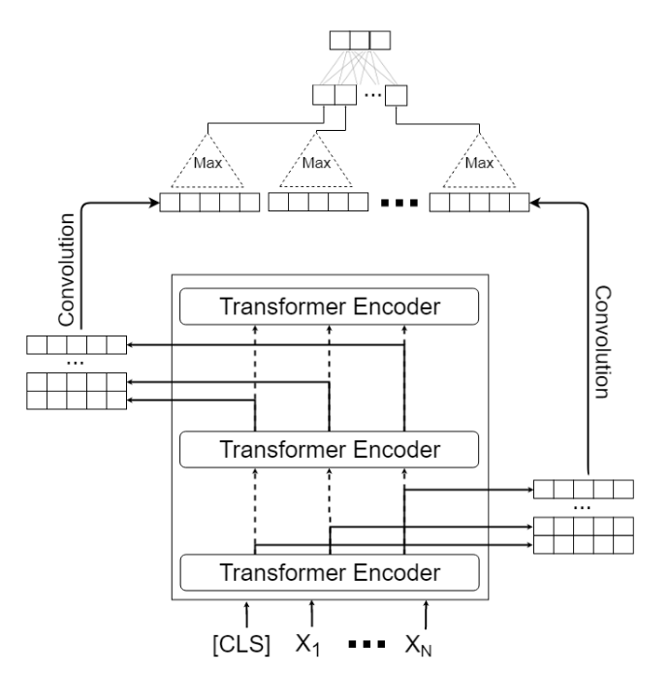
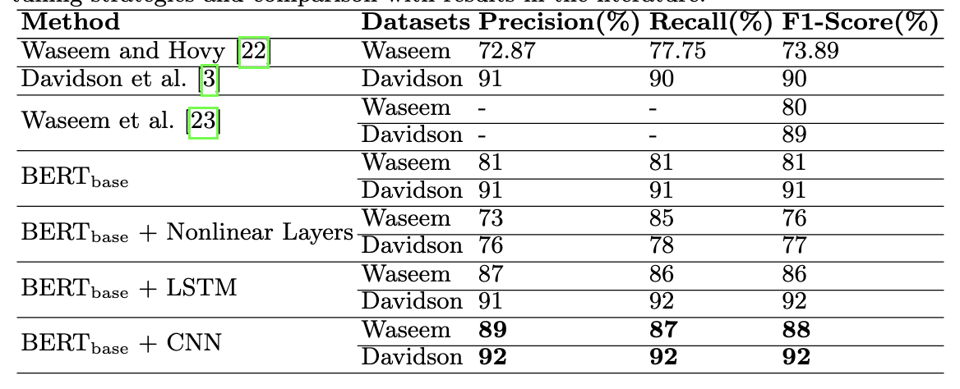
BERT for Hate Speech
Data: Waseem & Hovy (2016), 25k annotated tweets (Davidson et al, 2017; Twitter user guidelines)
Best method: BERT + CNN
Each layer of the transformer gives an output → CNN
Preprocessing: Replacing usernames, elongated words, hashtags; remove punctuation
Results:
Mozafari, M., Farahbakhsh, R., & Crespi, N. (2020). A BERT-based transfer learning approach for hate speech detection in online social media. In the 8th International Conference on Complex Networks and Their Applications. (pp. 928-940). Springer.
Notes:
the output vectors of each transformer encoder are concatenated, and a matrix is produced.
The convolutional operation is performed with a window of size (3, hidden size of BERT which is 768 in BERTbaseBERTbase model) and the maximum value is generated for each transformer encoder by applying max pooling on the convolution output. By concatenating these values, a vector is generated which is given as input to a fully connected network.
By applying softmax on the input, the classification operation is performed.
25k annotated tweets (92% agreement)
Method: word n-grams (1,2,3 characters) → Less psarse
TF-IDF: Yes
Other features
Classifier: (many) but L2 Logistic Regression best
0.91, 0.9, 0.9
Using the pre-trained BERT model as initial embeddings and fine-tuning the model with a fully connected linear classifier (BERTbase) outperforms previous baselines yield- ing F1-score of 81% and 91% for datasets of Waseem and Davidson respectively. Inserting a CNN to pre-trained BERT model for fine-tuning on downstream task provides the best results as F1- score of 88% and 92% for datasets of Waseem and Davidson and it clearly exceeds the baselines. Intuitively, this makes sense that combining all pre-trained BERT layers with a CNN yields better results in which our model uses all the information included in different layers of pre-trained BERT during the fine-tuning phase. This information contains both syntactical and contextual features coming from lower layers to higher layers of BERT.

Slide 29
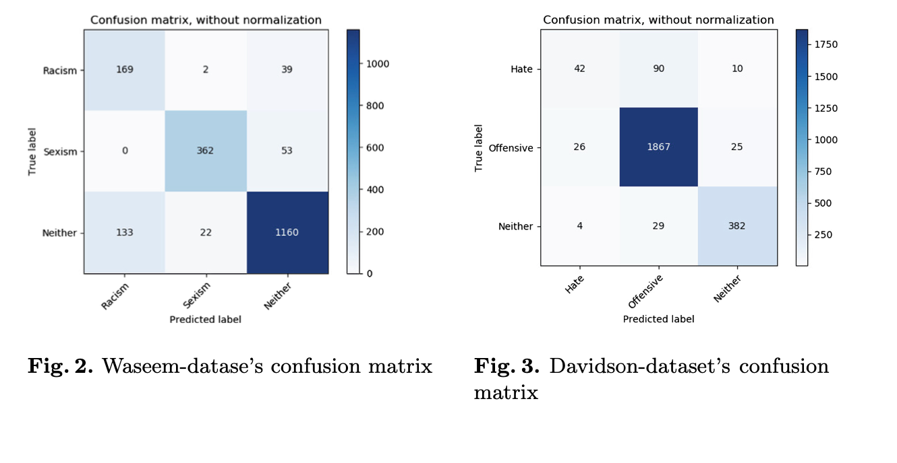
BERT for Hate Speech
Mozafari, M., Farahbakhsh, R., & Crespi, N. (2020). A BERT-based transfer learning approach for hate speech detection in online social media. In the 8th International Conference on Complex Networks and Their Applications. (pp. 928-940). Springer.

Slide 30
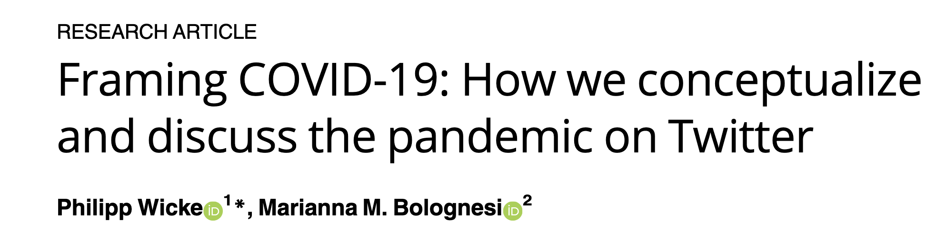

Application of Text Clustering in Media

Slide 31
COVID pandemic (Wicke & Bolognesi 2020)
Question:
- To what extent is the WAR figurative frame and the conventional metaphor DISEASE TREATMENT IS WAR used to talk about Covid-19 on Twitter?
- Which lexical units are used within this metaphorical frame and which lexical units are not?
- Framing of WAR (fight, combat, battle), STORM (wave, storm, cloud), MONSTER (evil, horror, killer) or TSUNAMI (wave, tragedy, catastrophe).
Data: Twitter around #Covid-19 (80 hashtags) - 25.000 tweets per day
Method: LDA (4 and 16 topics) + correlation of topics with frames
Preprocessing: Remove stop words, remove covid, remove tokes with less than 3 characters
Notes:
Consequently, we explored the actual usage of the WAR frame, and explored which topics (among the topics identified in the first part of the study) are more frequently framed within the metaphor of WAR.
To do so, we compiled a list of war-related lexical units and ran it against our corpus of Covid-19 tweets, observing and discussing which lexical units of each frame were used in the tweets, and within which topics.
The results show that 5.32% of all tweets contain war-related terms and are therefore likely to frame the discourse around Covid-19 metaphorically, in terms of a literal war.

Slide 32
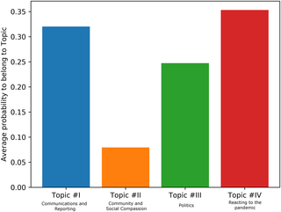
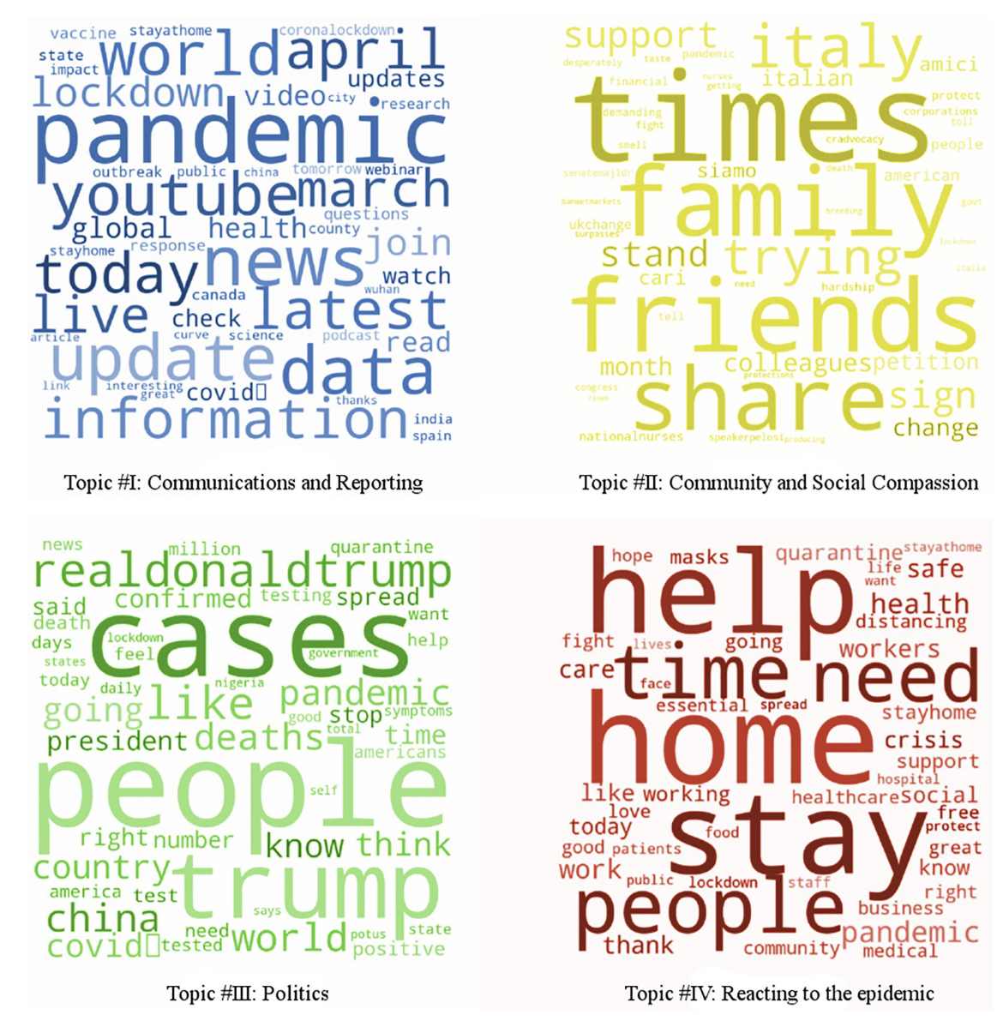
COVID pandemic (Wicke & Bolognesi 2020)
LDA-predicted average probability of WAR term contributing to one of 4 topics.
The results show that 5.32% of all tweets contain war-related terms

Slide 33
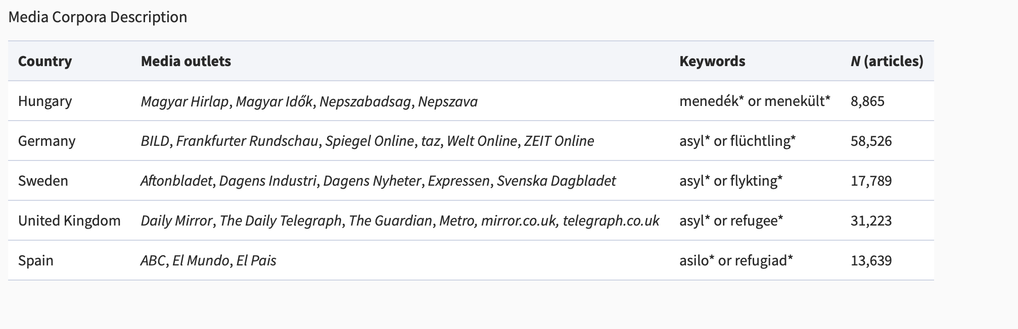
Refugees crisis (Heidenreich, Lind, Eberl & Boomgaarden, 2019)
Data: 130k articles from 24 news outlets
Method: LDA (10 topics per country) + manual labeling.
Preprocessing: Unclear
Validation: Semantic validity (are the topics distinctive) + Randomly reading three articles per topic/country + predictive validity (are important events such as elections reflected)
Notes:
Frequently found frames in migration coverage are the ‘Economy’ frame (e.g. migrant workers’ impact on the job market), the ‘Welfare’ frame (i.e. migrants’ impact on the welfare system), crime and security-related perspectives and an emphasis on political and legal processes (e.g. Gabrielatos and Baker 2008; McLaren et al. 2018
Hungary: Three key dynamics are visible (see Figure 2). First, before May 2015, media framing was mainly concerned with (international) ‘humanitarian aid’. However, as refugees arrived more numerously on Hungarian soil, the framing changed. In a similar way, a more general ‘crime and terrorism’ frame made way for the more specific ‘border’ frame—also concerned with the security of the country, although with a clearer focus (see also Georgiou and Zaborowski 2017). The peak of the ‘crisis’ is thus mirrored in media coverage by a peak in ‘border’ framing. Soon thereafter, the Hungarian government decided to close its border to Croatia (October 2015). After borders were closed, the framing shifted from the national level (i.e. ‘border’ and ‘national refugee policy’) to the European level (i.e. ‘EU refugee policy’). Hungarian media were waiting for European Union decision makers to find a solution to the ‘crisis’.

Slide 34
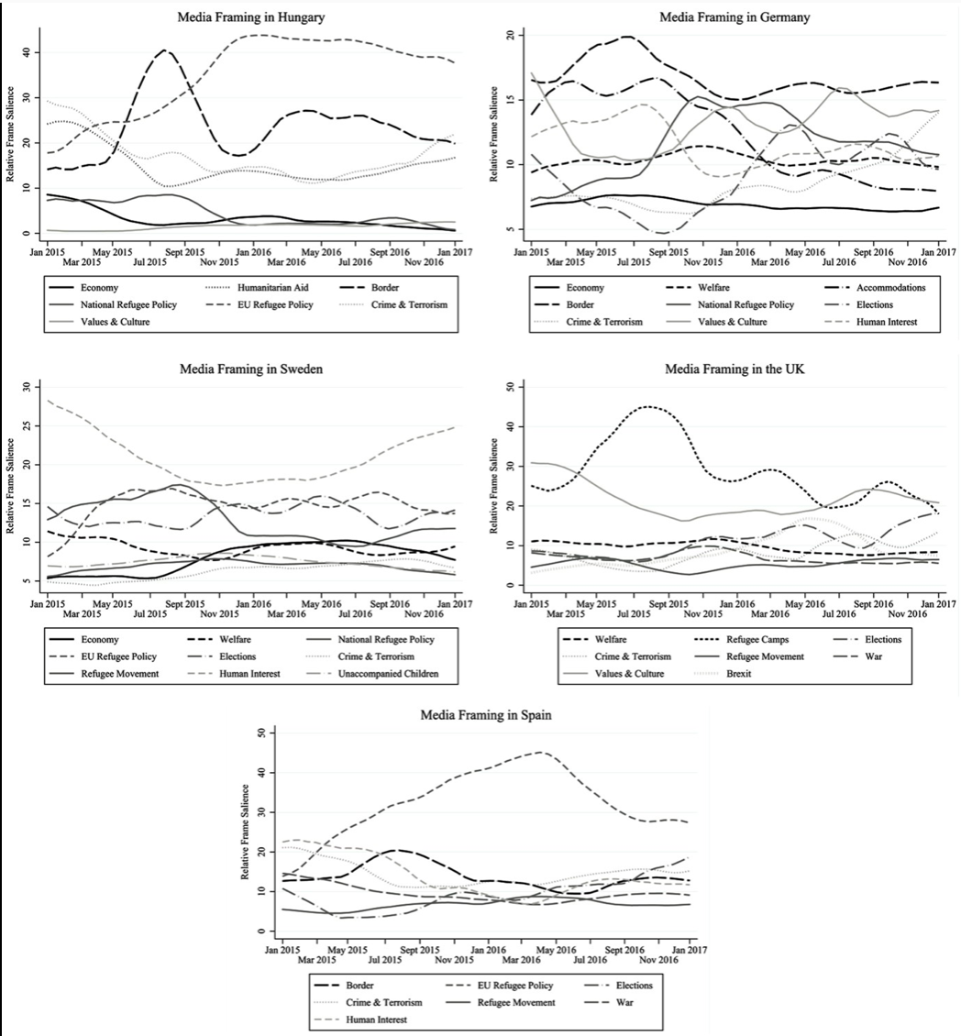
Refugees crisis (Heidenreich, Lind, Eberl & Boomgaarden, 2019)
Before May 2015, media framing was mainly concerned with (international) ‘humanitarian aid’
In October 2015, the Hungarian government decided to close its border to Croatia and the framing shifted to the European level (i.e. ‘EU refugee policy’)
Notes:
Hungary: before May 2015, media framing was mainly concerned with (international) ‘humanitarian aid’. However, as refugees arrived more numerously on Hungarian soil, the framing changed. In a similar way, a more general ‘crime and terrorism’ frame made way for the more specific ‘border’ frame—also concerned with the security of the country, although with a clearer focus (see also Georgiou and Zaborowski 2017).
The peak of the ‘crisis’ is thus mirrored in media coverage by a peak in ‘border’ framing. Soon thereafter, the Hungarian government decided to close its border to Croatia (October 2015). After borders were closed, the framing shifted from the national level (i.e. ‘border’ and ‘national refugee policy’) to the European level (i.e. ‘EU refugee policy’). Hungarian media were waiting for European Union decision makers to find a solution to the ‘crisis’.
Germany: In the months leading to the peak of the ‘refugee crisis’, the ‘border’ frame is most salient (see Figure 2). However, after Merkel’s well-known assertion ‘Wir schaffen das’ on 31 August, the frame decreased in importance, while the ‘national refugee policy’, the question of how to deal with refugees now that they are in the country becomes more relevant. In contrast to the other countries, the search for ‘accommodations’ plays a particularly important role in German media. Note that the ‘crisis’ also played an important role in the regional elections in March and September 2016.
Sweden: Generally, ‘human interest’ is the most salient frame over the whole period of analysis (see Figure 2). Findings are in line with previous studies on migration coverage in Sweden (e.g. Berry et al. 2016). However, the frame importance decreased with the peak of the ‘crisis’, at the same time as the frames ‘refugee movement’ and ‘EU refugee policy’ increased in salience. Once the height of the ‘crisis’ had passed, which also meant that fewer refugees would arrive in Sweden, the ‘human interest’ frame increased again.
United Kingdom: We can see two key dynamics (see Figure 2). The strongest frame used by United Kingdom media to describe the height of the ‘crisis’ is focused on ‘refugee camps’. The frame peaked in media coverage around August 2015; then there is a small peak in March 2016 as refugees were stuck in Idomeni and another one in October 2016 as the wretched refugee camp in Calais was cleared. Furthermore, around June 2016, a Brexit frame appears in refugee-related coverage. However, the frame decreases in salience again soon after.

Slide 35
Refugees crisis (Heidenreich, Lind, Eberl & Boomgaarden, 2019)
After Merkel’s well-known assertion ‘Wir schaffen das’ on 31 August, the ‘national refugee policy’, the question of how to deal with refugees now that they are in the country becomes more relevant
The search for ‘accommodations’ plays a particularly important role in German media
The ‘crisis’ also played an important role in the regional elections in March and September 2016
Notes:
Hungary: before May 2015, media framing was mainly concerned with (international) ‘humanitarian aid’. However, as refugees arrived more numerously on Hungarian soil, the framing changed. In a similar way, a more general ‘crime and terrorism’ frame made way for the more specific ‘border’ frame—also concerned with the security of the country, although with a clearer focus (see also Georgiou and Zaborowski 2017).
The peak of the ‘crisis’ is thus mirrored in media coverage by a peak in ‘border’ framing. Soon thereafter, the Hungarian government decided to close its border to Croatia (October 2015). After borders were closed, the framing shifted from the national level (i.e. ‘border’ and ‘national refugee policy’) to the European level (i.e. ‘EU refugee policy’). Hungarian media were waiting for European Union decision makers to find a solution to the ‘crisis’.
Germany: In the months leading to the peak of the ‘refugee crisis’, the ‘border’ frame is most salient (see Figure 2). However, after Merkel’s well-known assertion ‘Wir schaffen das’ on 31 August, the frame decreased in importance, while the ‘national refugee policy’, the question of how to deal with refugees now that they are in the country becomes more relevant. In contrast to the other countries, the search for ‘accommodations’ plays a particularly important role in German media. Note that the ‘crisis’ also played an important role in the regional elections in March and September 2016.
Sweden: Generally, ‘human interest’ is the most salient frame over the whole period of analysis (see Figure 2). Findings are in line with previous studies on migration coverage in Sweden (e.g. Berry et al. 2016). However, the frame importance decreased with the peak of the ‘crisis’, at the same time as the frames ‘refugee movement’ and ‘EU refugee policy’ increased in salience. Once the height of the ‘crisis’ had passed, which also meant that fewer refugees would arrive in Sweden, the ‘human interest’ frame increased again.
United Kingdom: We can see two key dynamics (see Figure 2). The strongest frame used by United Kingdom media to describe the height of the ‘crisis’ is focused on ‘refugee camps’. The frame peaked in media coverage around August 2015; then there is a small peak in March 2016 as refugees were stuck in Idomeni and another one in October 2016 as the wretched refugee camp in Calais was cleared. Furthermore, around June 2016, a Brexit frame appears in refugee-related coverage. However, the frame decreases in salience again soon after.

Slide 36
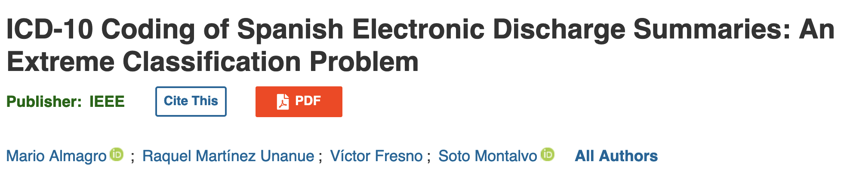

Applications in Health: Automating coding

Slide 37
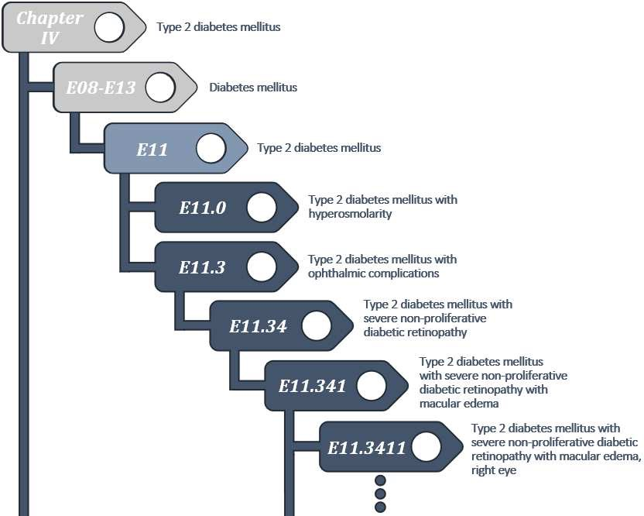
ICD-10 coding
Medical coding is used to identify and standardize clinical concepts in the records collected from healthcare services
The ICD- 10 is the most widely-used coding with more than 11,000 different diagnoses, affecting research, reporting, and funding

Slide 38
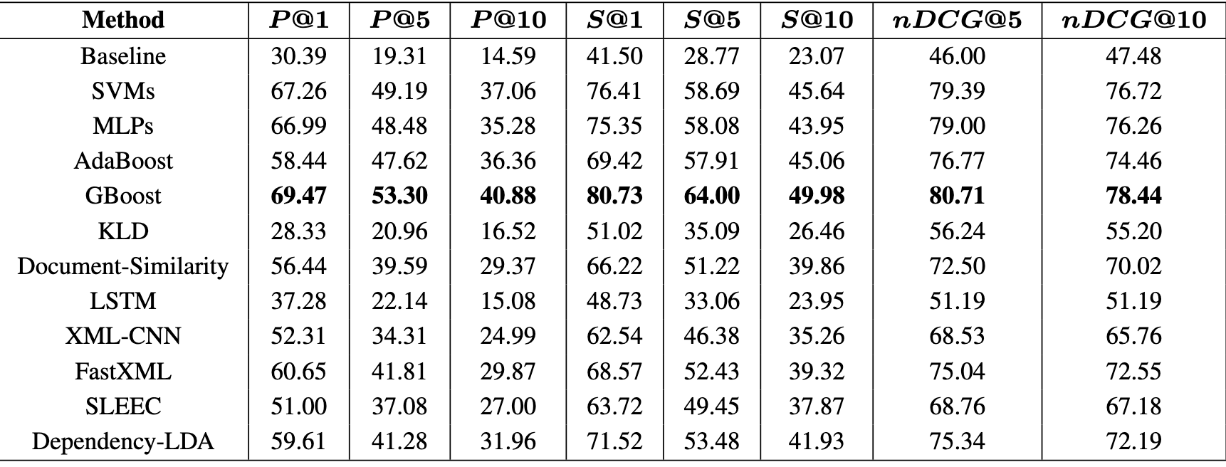
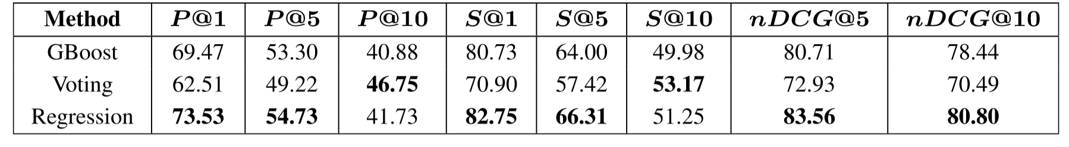
Almagro, Martínez-Unanue, Fresno, Moltalvo, 2020
Goal: Suggest a list of the 10 most probable ICD-10 codes (diseases, abnormal findings, causes of injury…) to experts
Data: 7k discharged reports, with 7k ICD-10 codes. Cardinality=10
Method: Different methods
Preprocessing: Remove sentences withoug technical terms (using tagging software), removal accents, punctuation, stemming.
Results:
Notes:
Baseline = most frequent

Slide 39
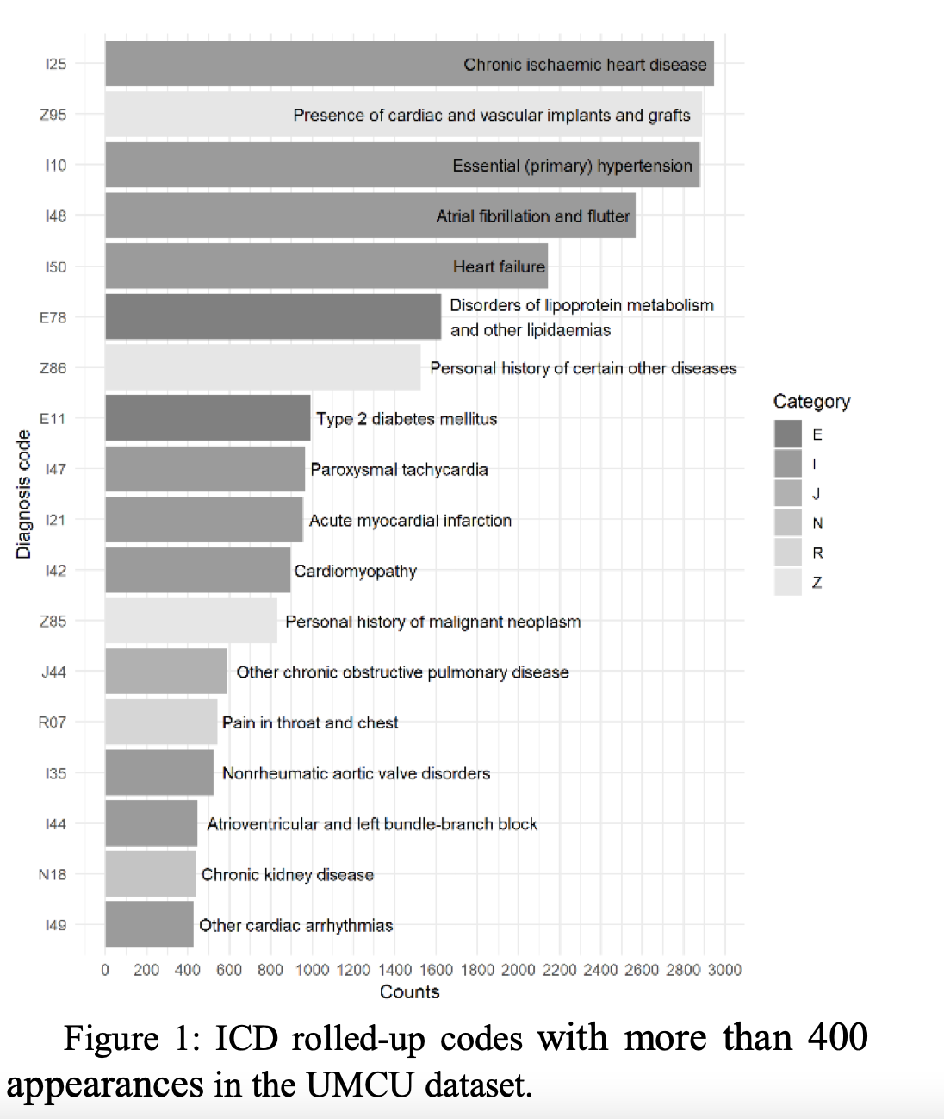
Bagheri, Sammani, van der Heijden, Asselbergs, Oberski, 2020
Question: The proposal is conceived to be applied in a real system, suggesting a list of the 10 most probable codes to experts
Data: 6k discharged reports, with 1k ICD-10 (diseases, abnormal findings, causes of injury…). Cardinality=5
Method: Different methods
Preprocessing: removed small labels, trimmed whitespaces, numbers and converted all characters to lowercase
Results:

Slide 40
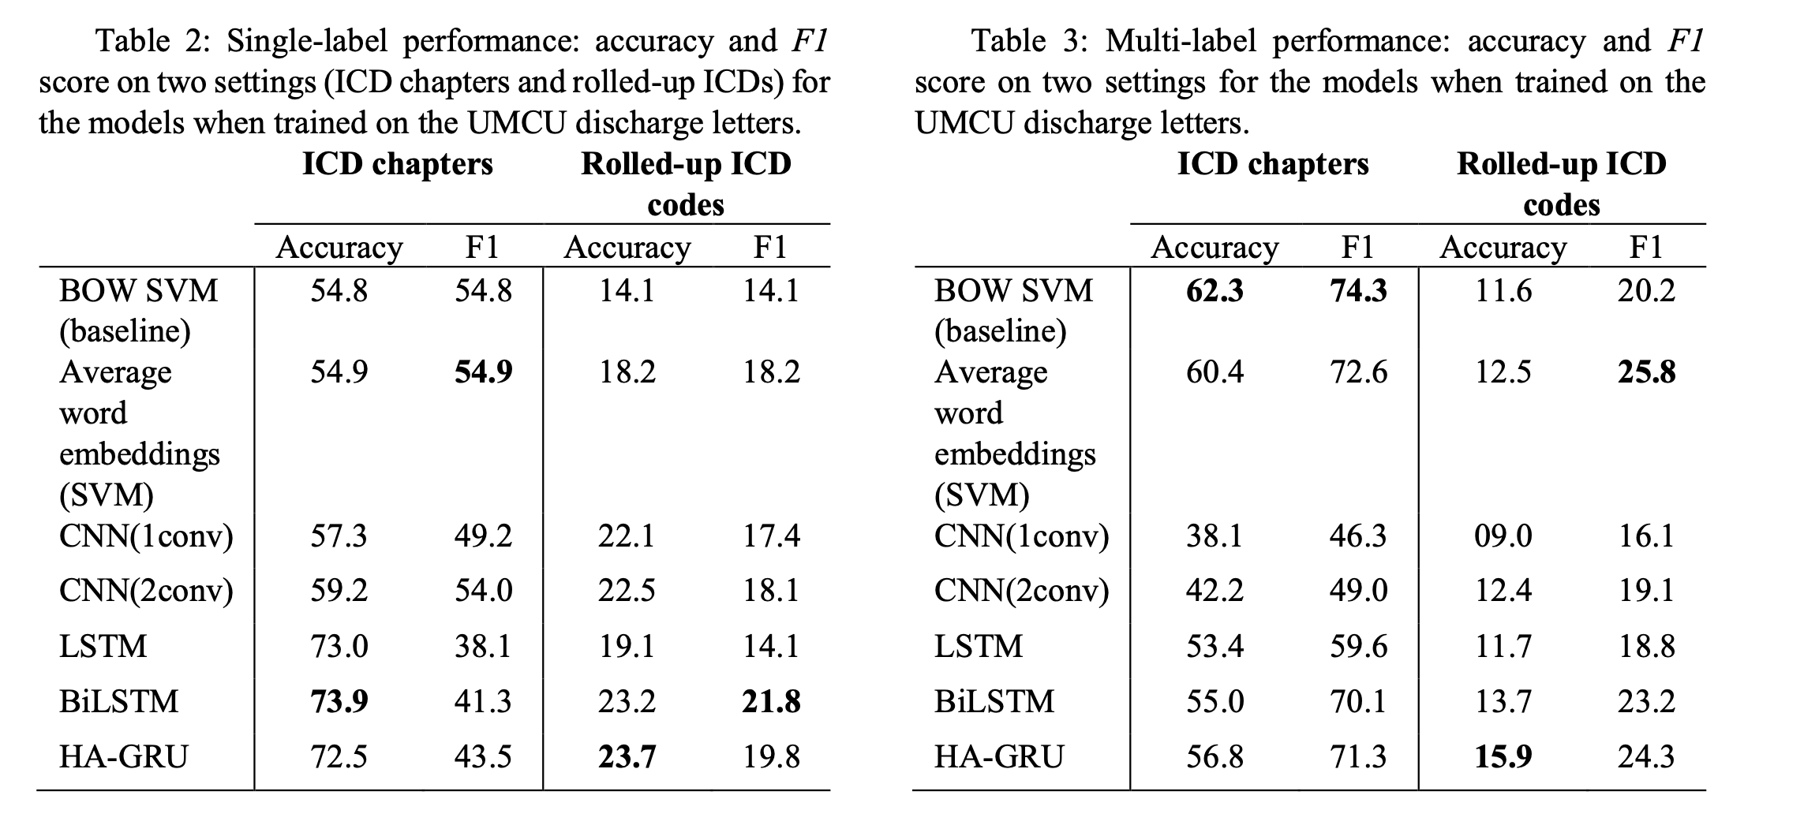
Bagheri, Sammani, van der Heijden, Asselbergs, Oberski, 2020

Slide 41
How to know if your results make sense?

Slide 42
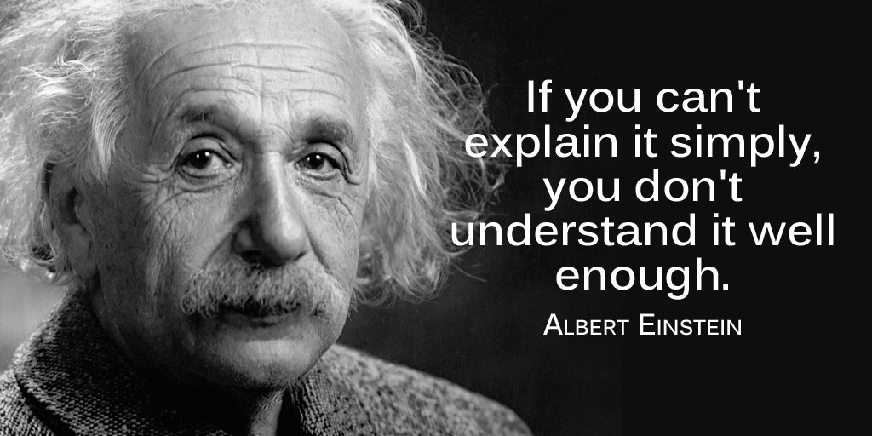
Interpretability in Supervised Learning
Notes:
Being Right for the Right Reasons

Slide 43
Interpretability Being right for the right reasons
Model-dependent
Designed for a particular type of model.
They leverage the inner workings and characteristics of the model to explain its behavior
Model-agnostic
Not tied to a specific model type and can be applied to any machine learning model
Global interpretability
Understanding the overall behavior of a model across its entire input space. Holistic view of the model's decision-making process and its underlying logic
Local interpretability
Explaining individual predictions.
Why a particular prediction was made by analyzing the specific input features that influenced the decision

Slide 44
Interpretability: Model-dependent
Notes:
Model-dependent interpretability techniques are designed specifically for a particular type of machine learning model. They leverage the inner workings and characteristics of the model to explain its behavior. These techniques often rely on model-specific properties, such as feature importance scores from decision trees or gradients in deep neural networks, to provide interpretability.
In contrast, model-agnostic interpretability techniques are not tied to a specific model type and can be applied to any machine learning model. These techniques focus on understanding the model's behavior without relying on its internal structure or properties. Model-agnostic interpretability methods often involve creating surrogate models or using post-hoc explanation techniques, such as feature importance scores or local perturbations, to gain insights into a model's predictions.

Slide 45
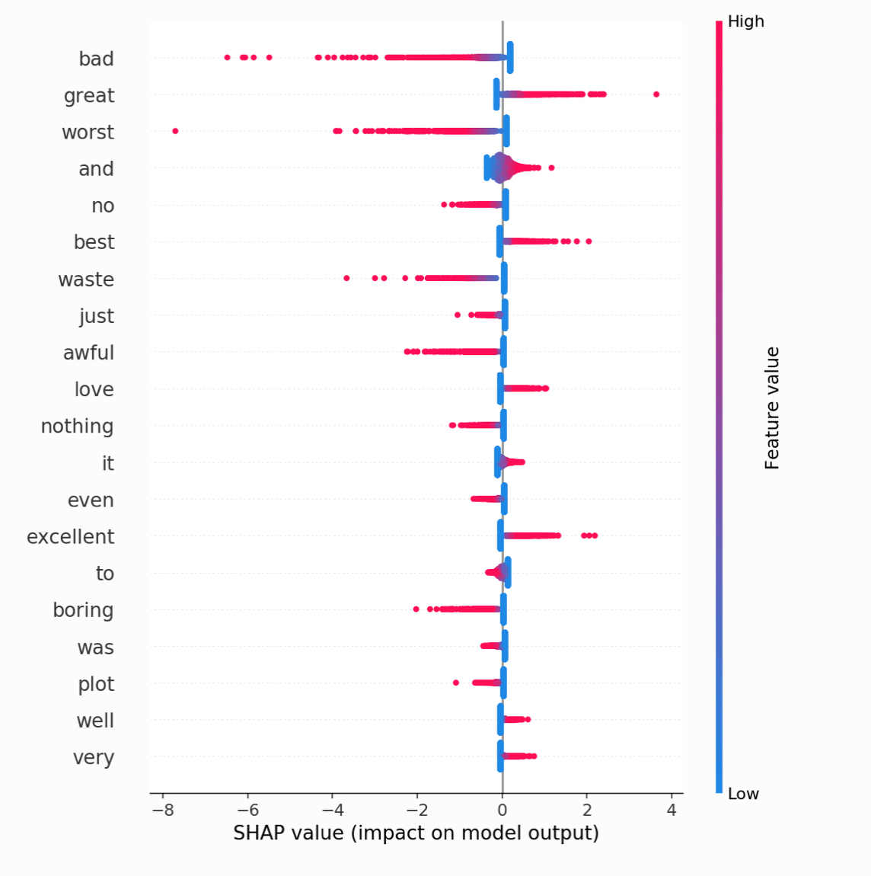
Global Interpretability
You train a sentiment analysis model
Analyze the feature importance scores or coefficients of the model
You find that features related to emotional words have higher importance scores
This global interpretability analysis reveals the common patterns and factors that contribute to the classification of document as positive or negative
Notes:
effect of all the features

Slide 46
Local Interpretability
You have a trained sentiment analysis model that classifies a document as positive or negative
You select a specific review classified as positive
Why the model made that prediction?
Analyze the most influential features or words in the article that contributed to the positive classification
Presence of words like ”good," ”amazing," had a strong positive influence on the model's decision
Notes:
In contrast, model-agnostic interpretability techniques are not tied to a specific model type and can be applied to any machine learning model. These techniques focus on understanding the model's behavior without relying on its internal structure or properties. Model-agnostic interpretability methods often involve creating surrogate models or using post-hoc explanation techniques, such as feature importance scores or local perturbations, to gain insights into a model's predictions.

Slide 47

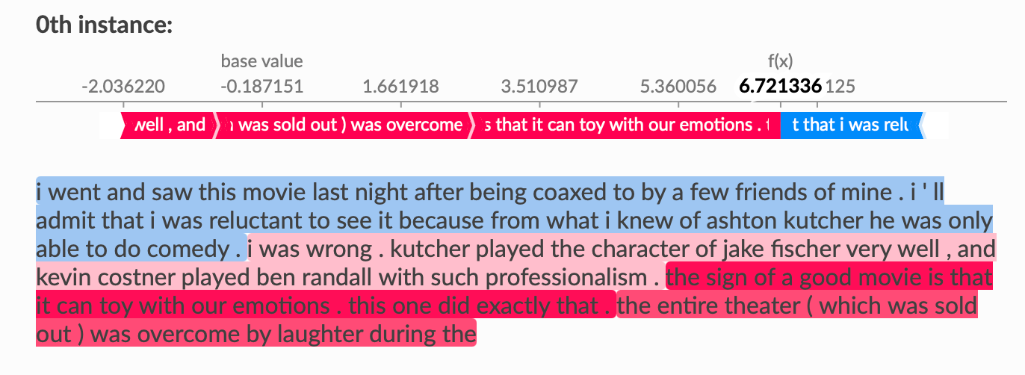
Local interpretability - SHAP
SHAP (SHapley Additive exPlanations) considers different combinations of players (features) to measure their individual contributions.
It evaluates the prediction for each combination of players and compares it to the prediction when some players are excluded. This helps quantify the importance of each player based on its marginal contribution
https://shap.readthedocs.io/en/latest/example_notebooks/text_examples/sentiment_analysis/Positive%20vs.%20Negative%20Sentiment%20Classification.html
Notes:
SHAP requires tensor outputs from the classifier, and explanations works best in additive spaces so we transform the probabilities into logit values (information values instead of probabilites).
Computation Process: SHAP considers different combinations of players (features) to measure their individual contributions. It evaluates the prediction for each combination of players and compares it to the prediction when some players are excluded. This helps quantify the importance of each player based on its marginal contribution.

Slide 48

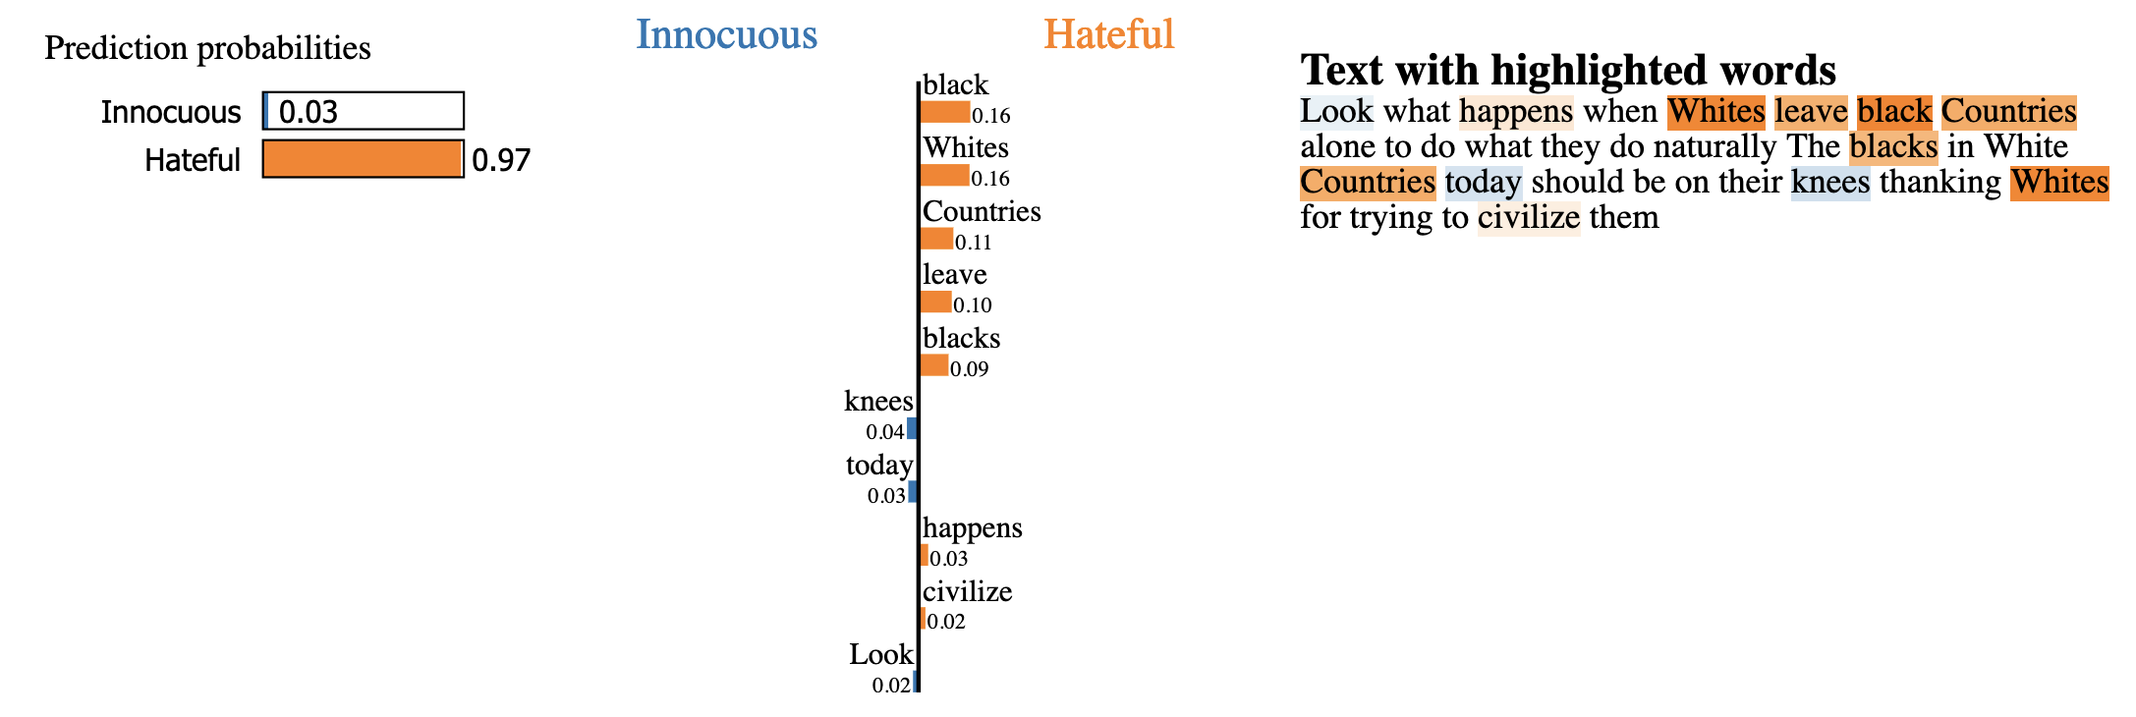
Local interpretability - LIME
LIME (Local Interpretable Model-Agnostic Explanations) creates simple and interpretable surrogate models for a prediction
It perturbs the input features of an instance and observes how the model's predictions change, allowing to identify the most important features influencing the outcome in a local and understandable way.
Notes:
LIME takes the instance we want to explain and creates slightly modified versions of it by making small changes to its features. These modifications aim to capture the important aspects that influenced the model's prediction.
The perturbation-based approach helps in generating modified instances that capture the important features, while surrogate models aid in approximating the behavior of the black-box model locally.
Surrogate Model: LIME creates a simpler and interpretable model called a surrogate model. It is trained on the modified instances and their corresponding predictions from the original black-box model.
Perturbation-Based Approach: LIME employs a perturbation-based approach to explain individual predictions. It involves creating modified versions of the input instance by making small changes to its features. These modifications aim to highlight the important aspects of the instance that influenced the model's prediction. The modified instances are then used to understand the behavior of the model locally.
Surrogate Models: Surrogate models, on the other hand, are simpler and interpretable models that approximate the behavior of the black-box model locally. In LIME, a surrogate model is trained on the modified instances and their corresponding predictions from the original black-box model. The surrogate model acts as a local approximation of the black-box model for the specific instance being explained.

Slide 49
Practical 9

